Slide 1


Flight of the osprey
Migration data: travel and rest days

Slide 2
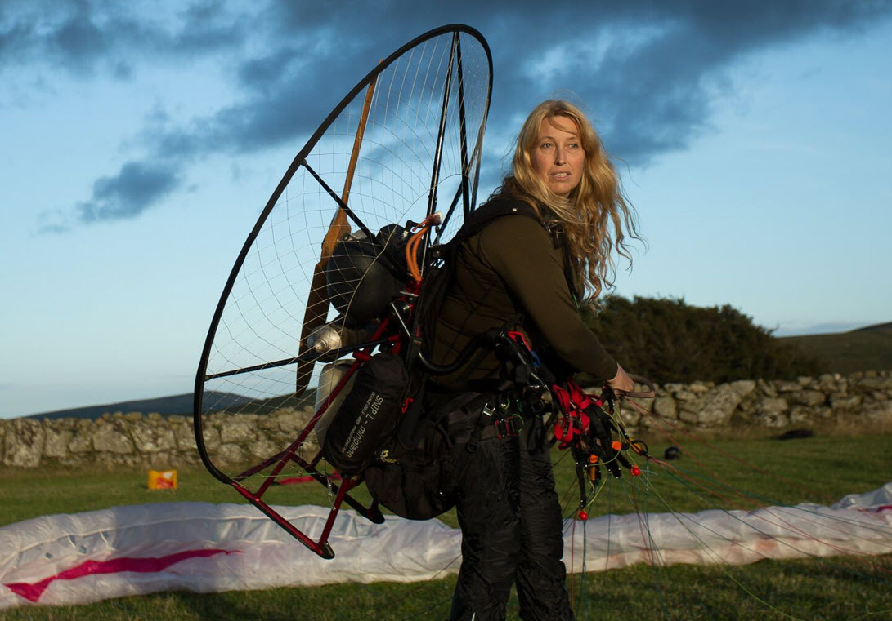
Welcome to the team!
Here is another task for you as a junior researcher.
Image © 2024 Conservation Without Borders. Permission granted.

Slide 3

Your next task
I need data represented as a graph to indicate osprey migration showing travel and rest days.
Here is the same data represented in two different ways.
Which type of graph should we use? Why?
Image © 2024 Conservation Without Borders. Permission granted.
Side-by-side column graph
Stacked column graph
Total days of migration journey for 2 birds showing travel and rest days

Slide 4
Side-by-side column graph
Notes:
This is a completed chart showing the 10 birds’ flight journeys as side-by-side column graphs.

Slide 5
Stacked column graphs
MIGRATORY BEHAVIOUR AND ECOLOGY OF A TRANS-SAHARAN MIGRANT RAPTOR, THE OSPREY PANDION HALIAETUS ​
Thesis submitted for the degree of ​Doctor of Philosophy - University of Leicester ​
Timothy Robert Mackrill BSc - Dept. Neuroscience, Psychology and Behaviour 2017​
Notes:
This is a completed chart showing the 10 birds’ flight journeys as stacked column graphs.

Slide 6
Research complete (for now!)
Thanks for your help today!​
I may call on you again.
Image © 2024 Conservation Without Borders. Permission granted.

