Slide 1
Pocket money
Mathematical modelling

Slide 2
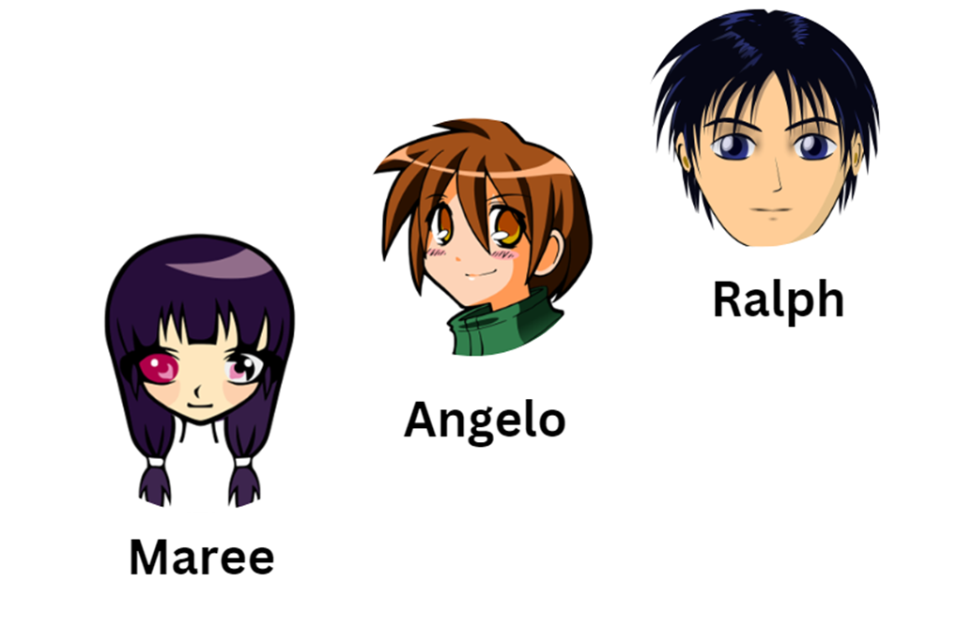
Pocket money problem
Maree and her two brothers help around the home.
A total of $15 per week is set aside for pocket money.
The children decide how to divide the $15 between them.
Notes:
https://pixabay.com/vectors/purple-hair-girl-young-teenager-312496/
https://pixabay.com/vectors/boy-teenager-teen-brown-hair-35706/
https://pixabay.com/vectors/boy-asian-anime-face-head-23714/

Slide 3
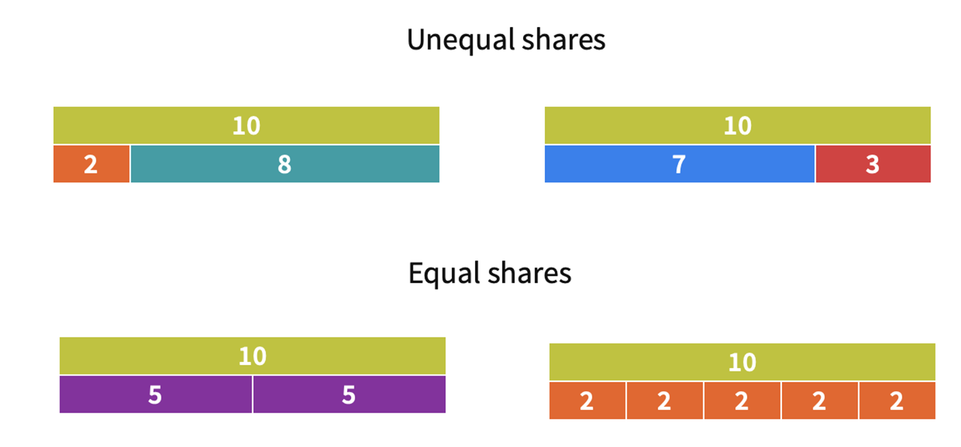
Sharing dollar amounts
Notes:
Revise from lesson (Pocket money: Partitioning money amounts)
Explain, sometimes we need to split/partition amounts (collections) into equal groups and sometimes we can make unequal groups. Each action requires the total amount (collection) to be split/partitioned. If we were to put the parts back together again we would have the whole amount/collection again.
Help students interpret the model.
•Which model shows $10 shared equally with each child getting $5?
•What model shows how $10 is divided equally paying the same amount for 5 jobs.
•Which model might show a representation of doing dishes and putting out the bins? Students explain their thinking.

Slide 4
Learning intention and success criteria
We are using mathematical modelling to solve problems involving money.
By the end of this lesson, I can:
use the 4-step problem solving method
use rounding to estimate the amount of money earned over a period of time
use efficient strategies to calculate the total cost of earnings over a period of time.

Slide 5
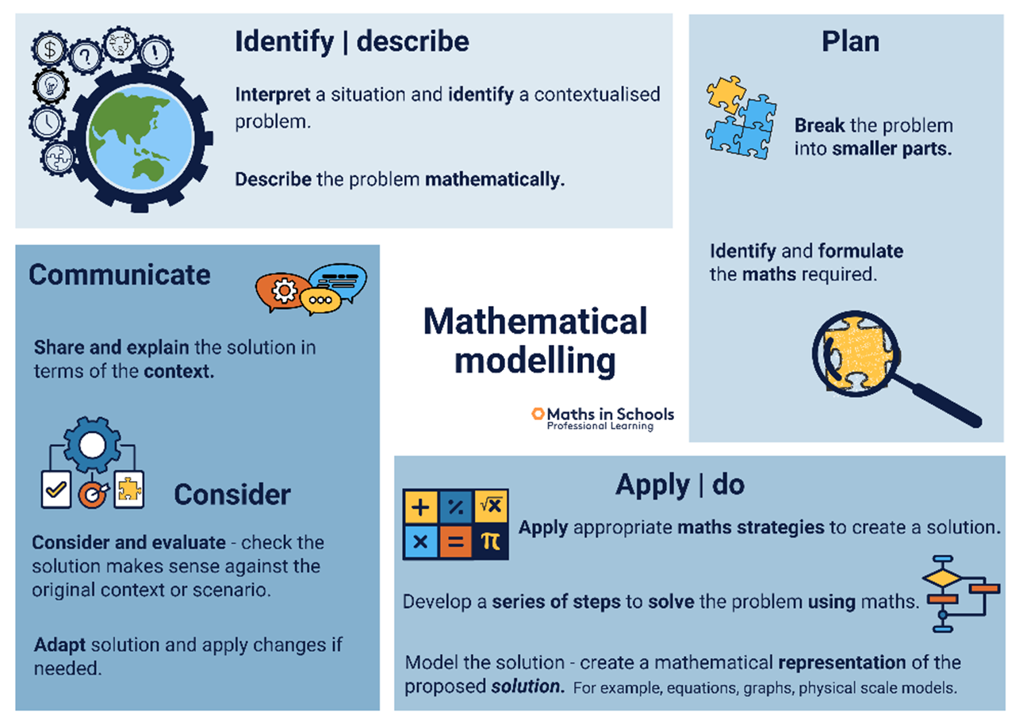
Problem solving approach
Notes:
Teacher notes: introduction
Explain that this is the problem solving approach we are going to use.
It has four stages and you will guide them through the process.
Poster and icons for 4 Step problem solving process from Maths in Schools Professional Learning

Slide 6

4 STEPS TO PROBLEM SOLVING - 1
What is the problem?
Describe the problem mathematically.
Notes:
Emphasise the importance of ‘Reading and Understanding’ the problem.
- Read the problem
- Read the problem again (one part at a time) identifying key words/numbers/symbols. Make pictures of the story in your mind.
- Say what is happening in the story to a friend
- What do we know? What do we need to find out?

Slide 7
Pocket money problem
Maree and her two brothers help around the home.
A total of $15 per week is set aside for pocket money.
The children decide how to divide the $15 between them.
Notes:
https://pixabay.com/vectors/purple-hair-girl-young-teenager-312496/
https://pixabay.com/vectors/boy-teenager-teen-brown-hair-35706/
https://pixabay.com/vectors/boy-asian-anime-face-head-23714/

Slide 8
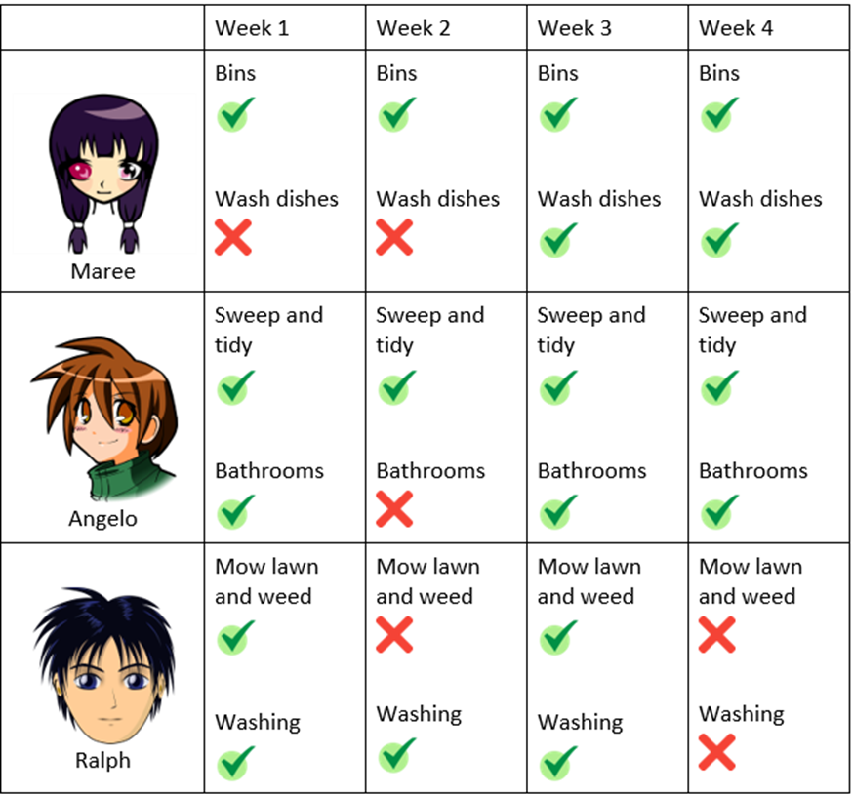
Task: Pocket money problem
Here are the ways they help around the home and the jobs they finished over a 4-week period.
A tick means the job was completed.
A cross indicates that the job was not completed.
Notes:
https://pixabay.com/vectors/purple-hair-girl-young-teenager-312496/
https://pixabay.com/vectors/boy-teenager-teen-brown-hair-35706/
https://pixabay.com/vectors/boy-asian-anime-face-head-23714/
Tick and cross ‘image: Flaticon.com'

Slide 9
Dividing pocket money
Show the different ways the pocket money could be divided between the three children each week.
How do you think the pocket money should be divided?
Notes:
https://pixabay.com/vectors/purple-hair-girl-young-teenager-312496/
https://pixabay.com/vectors/boy-teenager-teen-brown-hair-35706/
https://pixabay.com/vectors/boy-asian-anime-face-head-23714/
Tick and cross ‘image: Flaticon.com'

Slide 10

4 STEPS TO PROBLEM SOLVING - 2
Break the problem into smaller parts.
Identify the maths needed.
Notes:
- How are you going to attack the problem? Start somewhere. Give something a try.
- What possible strategies could you use?

Slide 11
PROBLEM SOLVING STRATEGIES
Here are a few strategies you could use:
draw a picture
make a model
write a number sentence
work backwards
make a table of information.
Notes:
- How are you going to attack the problem? Start somewhere. Give something a try.
- What possible strategies could you use?

Slide 12
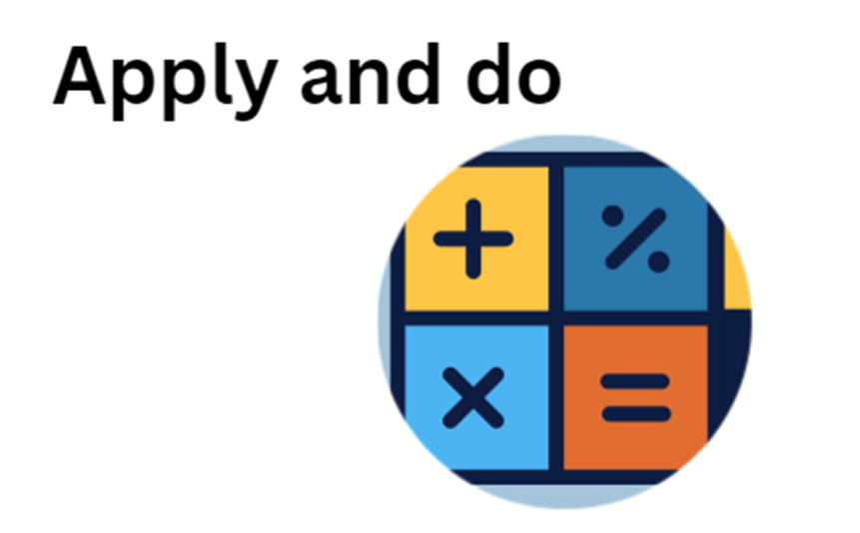
4 STEPS TO PROBLEM SOLVING - 3
Develop a series of steps to solve the problem using maths.
Create a representation of your solution.
Notes:
- Solve it, carry out the plan
- Try and see if it leads to a solution.
- If your plan is not working, show a growth mindset and try a different approach.
- Keep trying until you find a solution.

Slide 13

4 STEPS TO PROBLEM SOLVING - 4
Develop a series of steps to solve the problem using maths.
Create a representation of your solution.
Notes:
- Look back over your work and check your calculations. If the solution does not work, persist with your current attempt rather than restarting the problem. You need to analyse your working out and be flexible with your thinking.
- Ask yourself, does the solution answer the question? Is your solution reasonable?

Slide 14
RECALL STEPS TO PROBLEM SOLVING
Notes:
Who can recall the 4 steps that can be followed in a cycle?
This slide animates on a mouse click.

