Slide 1
Buying presents
Mathematical modelling

Slide 2
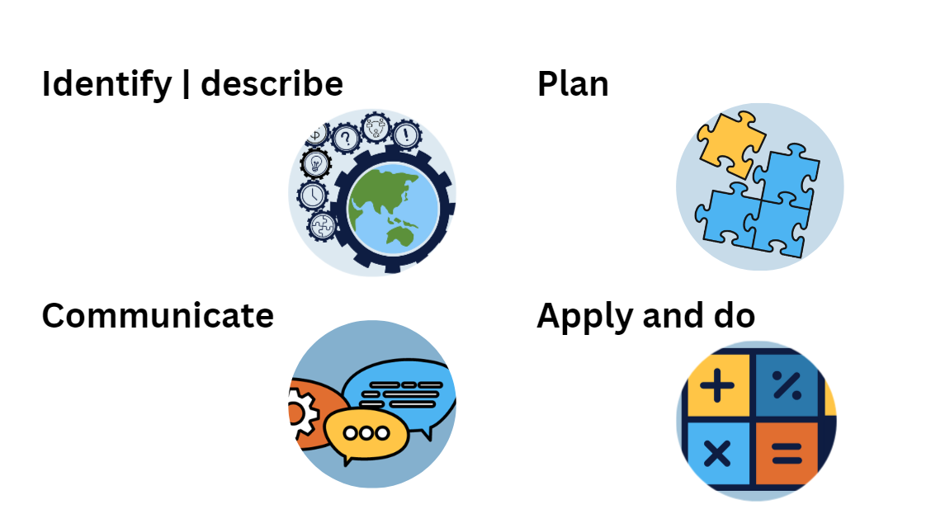
4 STEPS TO PROBLEM SOLVING

Slide 3
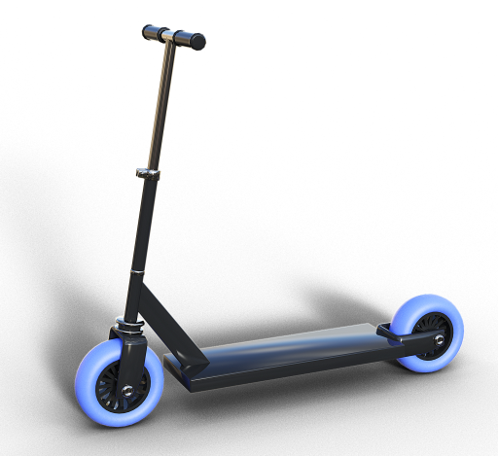
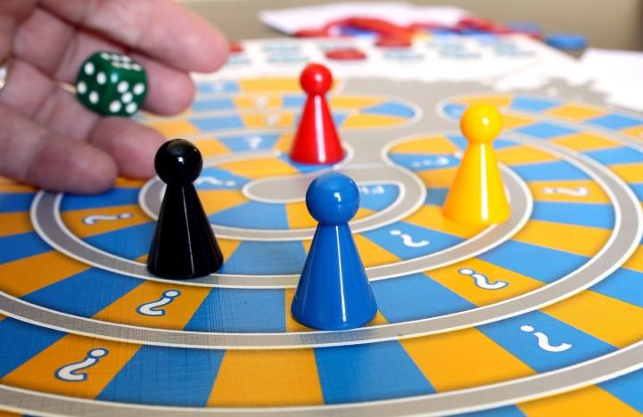

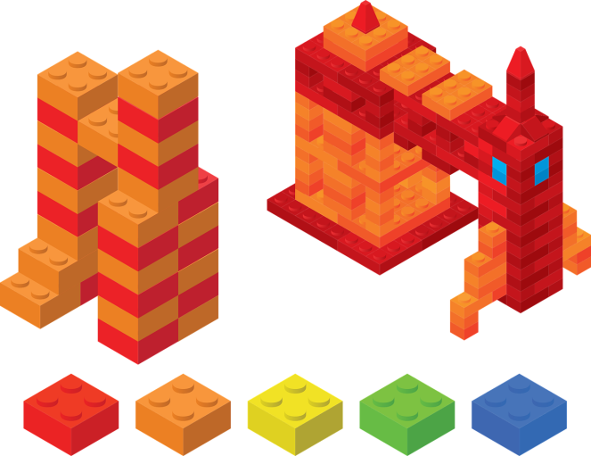
The problem
Wally wants to buy a present for each of his nieces and nephews. He has two nieces and three nephews.
They are all between 10 and 12 years old.
He has a budget of $600.
He has narrowed it down to four items.
Scooter: $96 each | Family board game: $65 each
Basketball: $89 each | Building blocks kit: $109 each

Slide 4
Your task
Scooter: $96 each | Family board game: $65 each
Basketball: $89 each | Building blocks kit: $109 each
Choose how Wally could spend the money to buy the presents for his nephews and nieces.
Use rounding to estimate first and then show some different ways Wally could spend the money.

Slide 5
Use the 4-STEP PROBLEM SOLVING MODEL

Slide 6
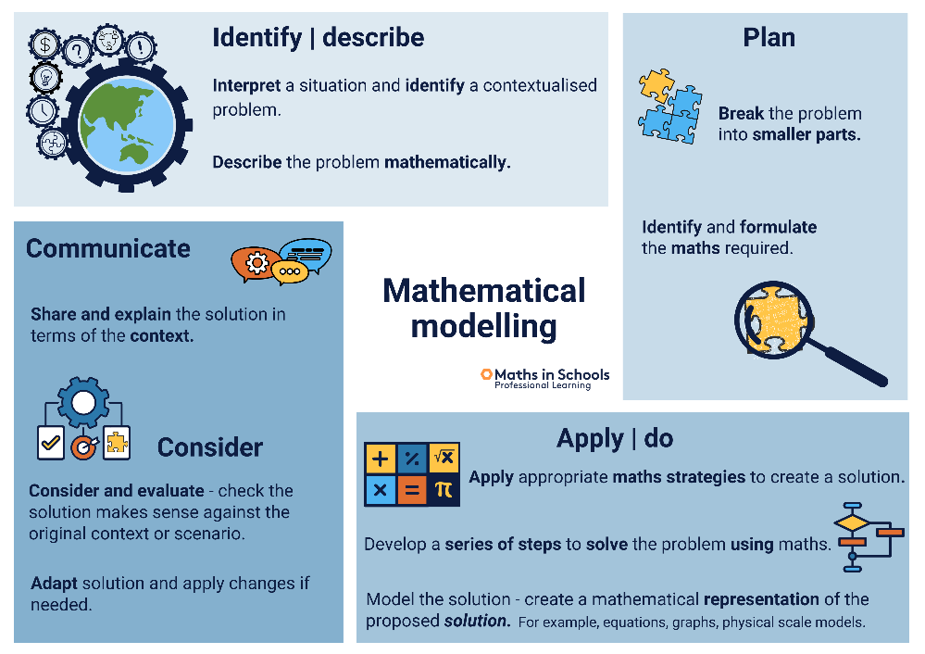
Image sources
Icons for 4 Step problem solving process from Maths in Schools Professional Learning
Images
https://pixabay.com/photos/family-game-game-board-game-588908/
https://pixabay.com/illustrations/scooter-children-scooter-locomotion-3128709/
https://pixabay.com/vectors/basketball-icon-ball-isolated-1731918/
https://pixabay.com/vectors/legos-toy-build-building-rocket-4338371/

