Slide 1



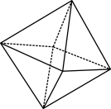

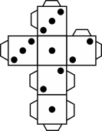
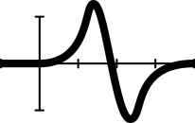


Capital Airways: Part 1
Notes:
Image: Free download via Pexels: CCO
Year 10
Space/Algebra
60 mins
AC9M10SP02, AC9M10A04
Lesson summary
This is the first of two lessons in the Capital Airways series. Students are introduced to the concept of a network through an airline route map. The task extends into a detailed mathematical modelling activity with students exploring in teams how to re-design the network map to improve the airline’s profitability.
Learning intention
We are learning the key language associated with networks.
We are learning to understand how to create and interpret network diagrams.
We will learn the complexities in building mathematical models and begin to tackle a modelling problem.
Success criteria
By the end of this lesson, students can:
name and describe the key features of a network diagram
interpret a network diagram to answer practical problems
amend/create a network diagram to meet specific criteria
use or build a mathematical model in a spreadsheet to optimise financial outcomes.
Why are learning this?
In today's lesson, we're learning to create, interpret, and manipulate network diagrams—a skill set applicable in logistics, computer science, and social sciences. Additionally, we're delving into the complexities of mathematical modelling, equipping you to use or build a spreadsheet model to optimise financial outcomes, providing practical problem-solving tools for real-world scenarios with many business applications.

Slide 2

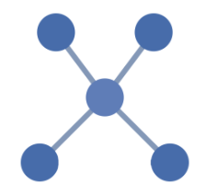
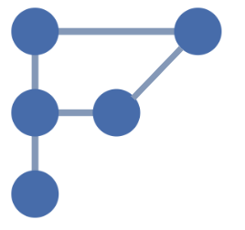
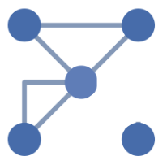
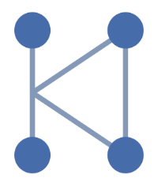
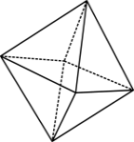

Which one doesn’t belong?
A
B
C
D
Notes:
Images created in Canva.com
Prerequisite student knowledge and language
Preferred: Some understanding of basic spreadsheet functionality including cell referencing and performing calculations using symbols such as = * and /
Students will draw on their personal experience/understanding of the airline business, although no specialist knowledge is assumed.
Language important for this lesson includes: node, vertex, edge, connected network, degree.
Learning hook
Begin by asking students to identify the diagram that doesn’t belong; ask students to justify their answers.
Review students’ responses as a class. (If students have already been introduced to networks encourage students to use the formal language of vertex/node, edge and connected network.) Possible responses include:
A, because there are only four lines (edges) while the others have five OR because it doesn’t have an enclosed shape, while the others do OR because it is the only diagram where it is not possible to travel along all the edges without repeating an edge.
B, because the dots (vertices) are not arranged in a square / rectangular shape, while the others are.
C, because one of the vertices is not connected to the others.
D, because there are only four vertices while the others have five OR because the edges do not directly connect the vertices with some edges meeting other edges (hence this is not a simplified network diagram).
Other answers are possible.

Slide 3
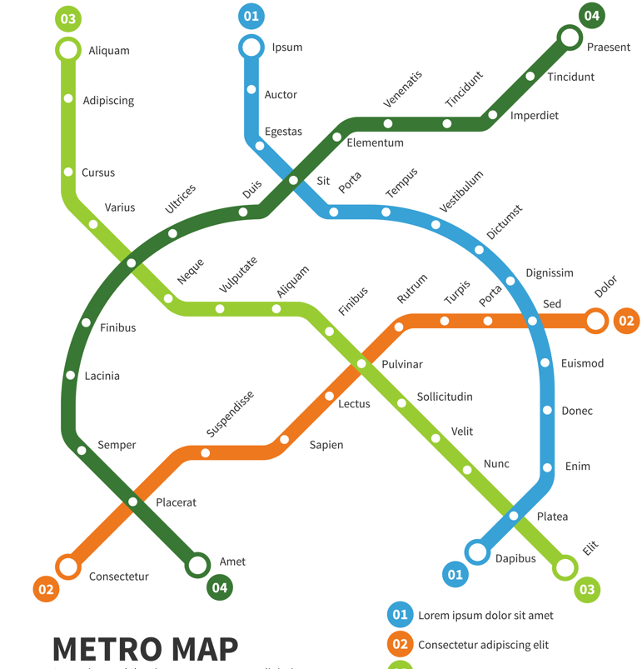
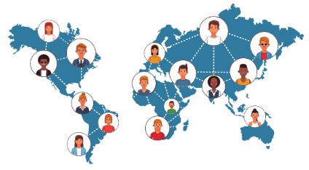

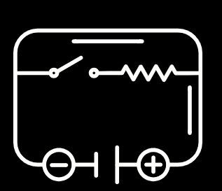
Introducing networks
Network diagrams are a simplified visual way of representing connections between people, places and objects.
Notes:
Images:
Metro subway map by macrovector on Freepik
Social network and people by Giuseppe Ramos J on Canva
Electric circuit icon by JM graphics on Canva
Cloud computing icon by SatawatFoto on Canva
Please note that this slide is animated. Pictures appear on the click of the mouse for a slow reveal of different types of networks.
If this is the class’s first lesson exploring the concept of networks, refer to slides 3 and 4. Use the questioning strategy to get students thinking deeply about the content.
For instance:
ask ‘what could these diagrams represent?’ to elicit the concept of network diagrams being a simplified visual way of representing connections between people, places and objects. Also refer to the slide examples: a circuit diagram, train map, basic IT network and social network.
ask questions about scale and accuracy, for instance, ‘does the train map exactly follow the train lines? If not, why not?’ to elicit the understanding that network diagrams do not need to be drawn perfectly to scale and to show the exact position of items, rather to just show the relationships.

Slide 4
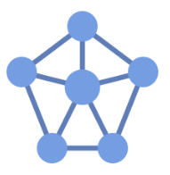
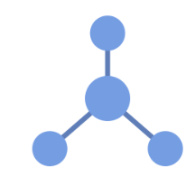
The language of networks
A vertex (plural ‘vertices’) is represented by a circle or dot in a network diagram. It may also be called a node.
Vertices are often given labels to indicate what is being represented, for example, the name of a person, place or computer.
NETWORK DIAGRAMS
An edge is the line segment that joins two vertices.
Edges are often given a weight, which is a number that represents the relationship between two vertices, such as a distance, travel time or cost.
EDGE
VERTEX
The degree of a vertex is a number indicating how many edges are connected to it. This vertex has degree 3.
Notes:
Image created in Canva
Please note that this is an animated slide to reveal the components of a network diagram one after another.
Introduce the metalanguage of networks, defining the terms vertex/node, edge and degree.

Slide 5
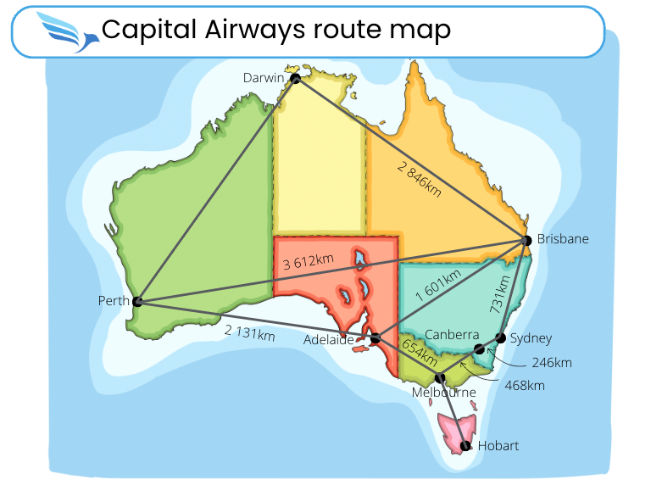
Activity 1 – Exploring the Capital Airways network
You are the new CEO (Chief Executive Officer) of Capital Airways, a small airline whose proud boast is: ‘We can fly you to every Australian capital.’
You’ve been given the network (route) map for Capital Airways and want to get to know the airline a bit better and understand where you fly.
Use the network map to answer the questions, working with a partner if necessary.
Notes:
Image created in Canva.com using Map of Australia with borders of states care of KVASVECTOR.
Interpreting network diagrams
Introduce Activity 1: Exploring the Capital Airways network using slide 5.
Explain the scenario:
‘You are the new CEO (Chief Executive Officer) of Capital airways, a small airline whose proud boast is that we can fly you to every Australian capital. You want to get to know the airline and understand where the company flies and so you have been given the network (route) map for Capital airways.’
The task is to use the network map to answer the questions in the worksheet. Students work in pairs or individually.
Monitor student’s progress and review answers as a class.
Differentiation (extend): question 14 provides an (optional) opportunity to explore the concept of Eulerian walks.

Slide 6
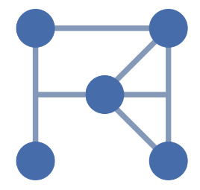
Summary
Network diagram
Edge
Node
Vertex
Vertices
Degree
Notes:
Image created in Canva.com

Slide 7
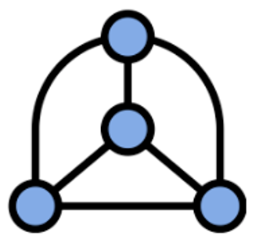
Quiz: Question 1
How many edges are there in this network diagram?
I’m not sure
6
4
5
Notes:
Image created in Canva.com
An interactive version of this three-part quiz can be accessed here: https://take.quiz-maker.com/QBNUR1KSA

Slide 8
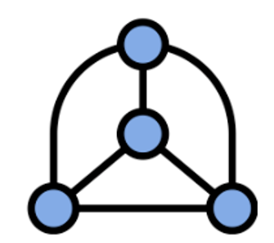
Quiz: Question 2
What are the names of the blue dots in this network diagram? Select all that apply.
Vertices
Paths
Edges
Nodes
I’m not sure.
Notes:
Image created in Canva.com

Slide 9
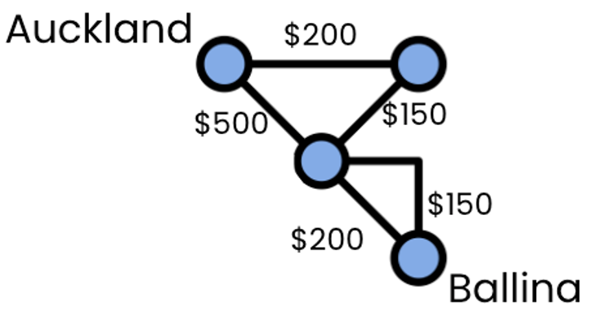
Quiz: Question 3
There is no direct flight from Auckland to Ballina. The different possible routes and ticket prices are shown in the network diagram below. What is the cheapest cost to travel from Auckland to Ballina?
$500
$550
$650
$700
Notes:
Image created in Canva.com

