Slide 1
Units of measurement for capacity

Slide 2
Learning intentions
We are learning about the units of measurement for capacity and how to convert between them, with and without a calculator.
We are practicing to read, speak and interpret numbers beyond 1000 in real-world contexts.

Slide 3
Why do I need to know this?
Converting measurements to the same unit of measure provides a common language for working with and comparing the sizes of the measurements (smaller, bigger, the same size).
Shortening a measurement number by converting it to an equivalent unit of measurement can make it easier to read and work with (easier to read 58 millilitres than 0.058 litres).

Slide 4



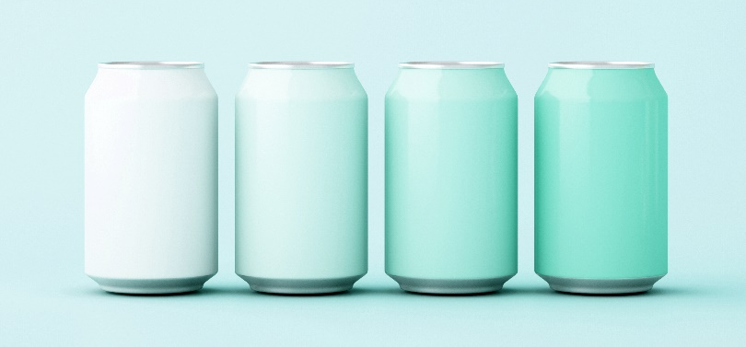
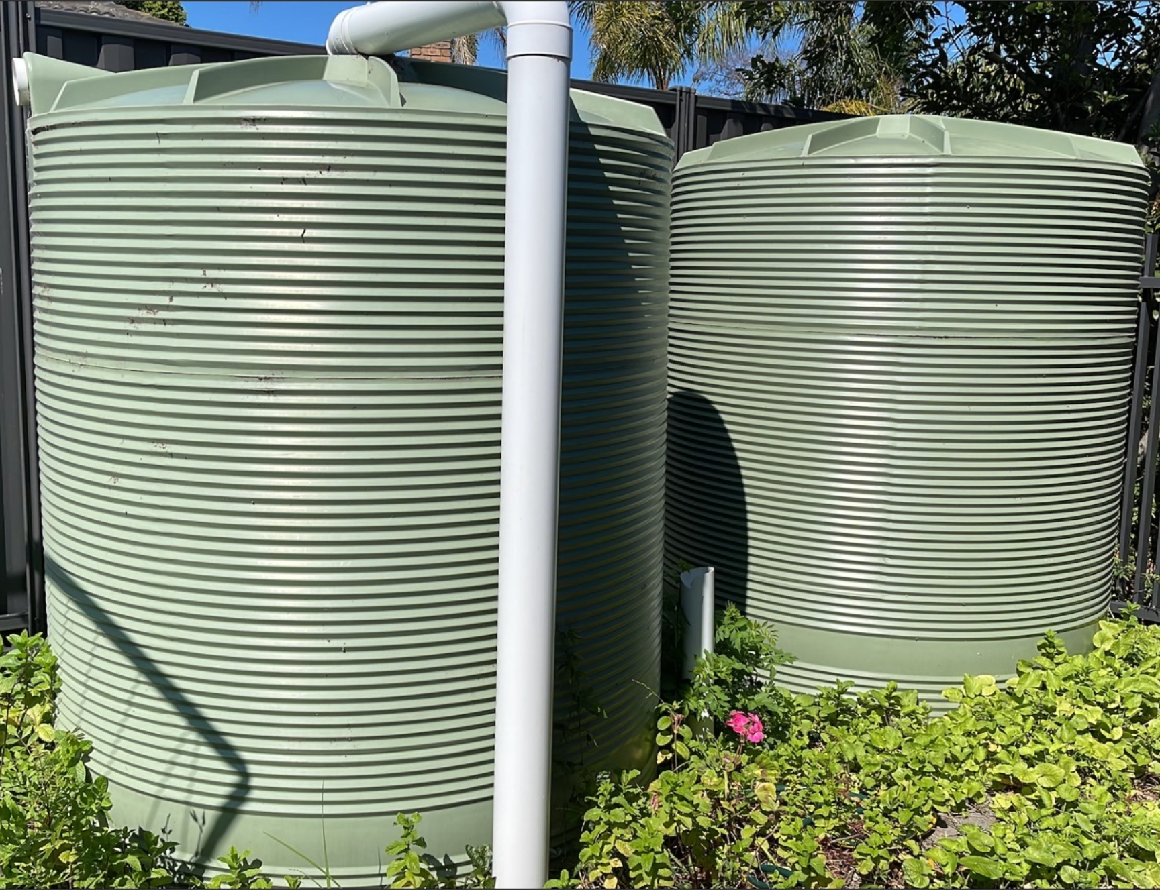
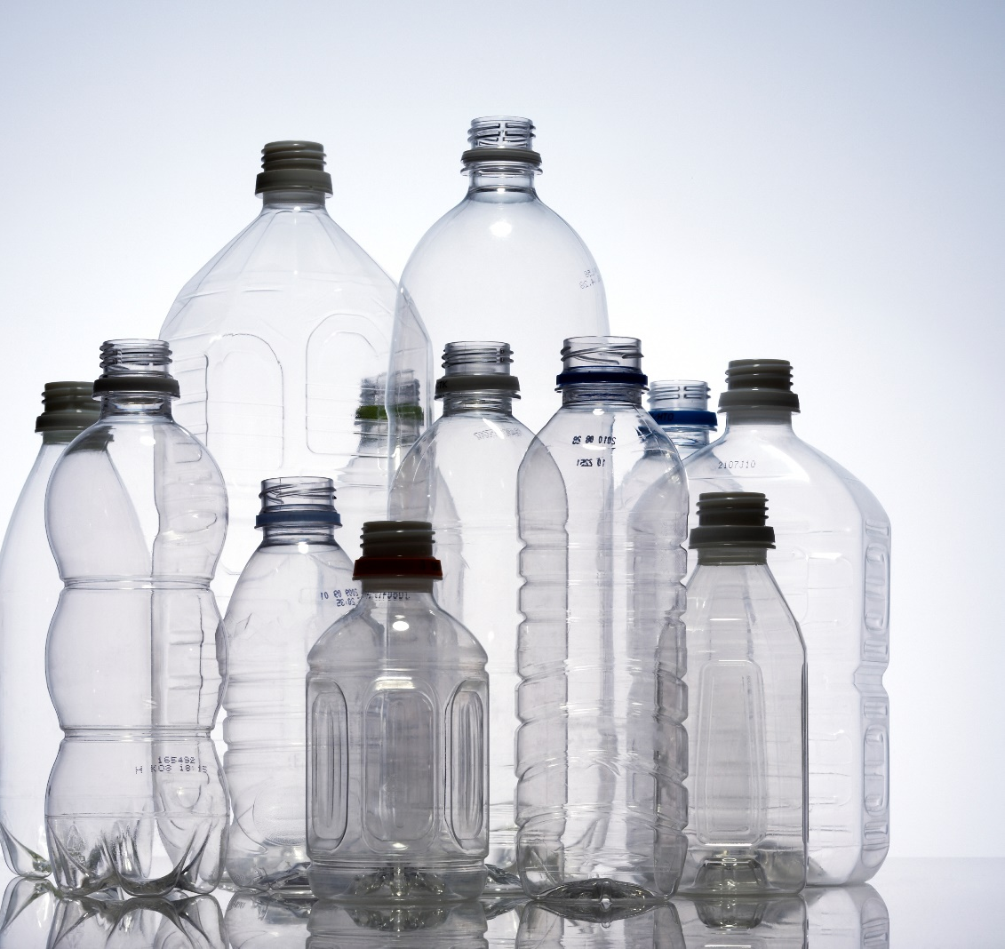
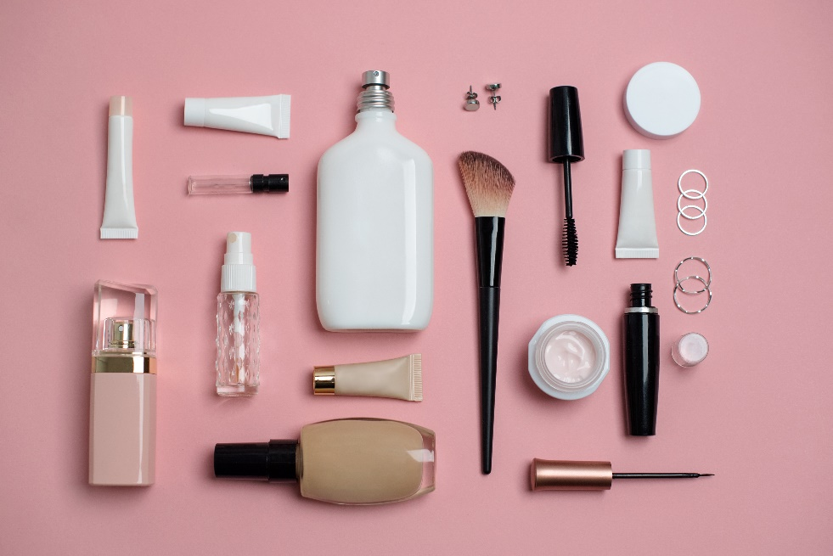
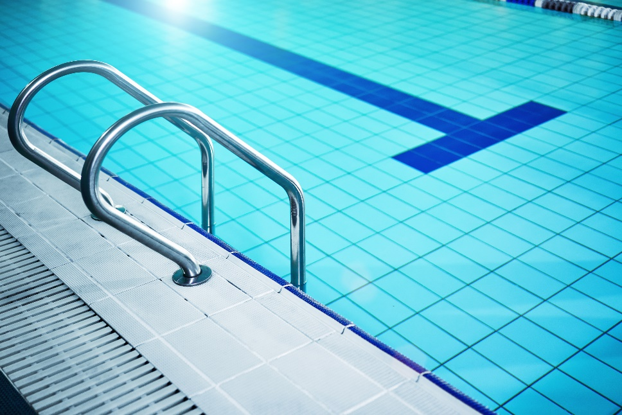

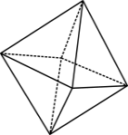
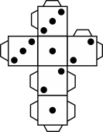

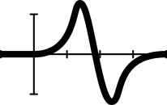

Which objects might have these units of measurement?
millilitres (mL) list at least 2 examples
litres (L) list at least 2 examples
kilolitres (kL) list at least 1 example
megalitres (ML) list at least 1 example

Slide 5
Litres of water used at home
Class size | Litres used per student per day | Litres used by class per day | Litres used by class per week | Litres used by class per month (30 days) | Litres used by class per year (365 days)
15 | 154 | 2310 15 x 154 | 16,170 7 x 2310 | 69,300 30 x 2310 | 843,150 365 x 2310
25 | 154 | 3850 | 26,950 | 115,500 | 1,405,250
30 | 154 | 4620 | 32,340 | 138,600 | 1,686,300

Slide 6
Number names and place values
Name | Amount | Number of Zeros | Groups of (3) Zeros '000'
Ten | 10 | 1
Hundred | 100 | 2
Thousand | 1,000 | 3 | 1
Ten thousand | 10,000 | 4
Hundred thousand | 100,000 | 5
Million | 1,000,000 | 6 | 2
Billion | 1,000,000,000 | 9 | 3
Trillion | 1,000,000,000,000 | 12 | 4

Slide 7
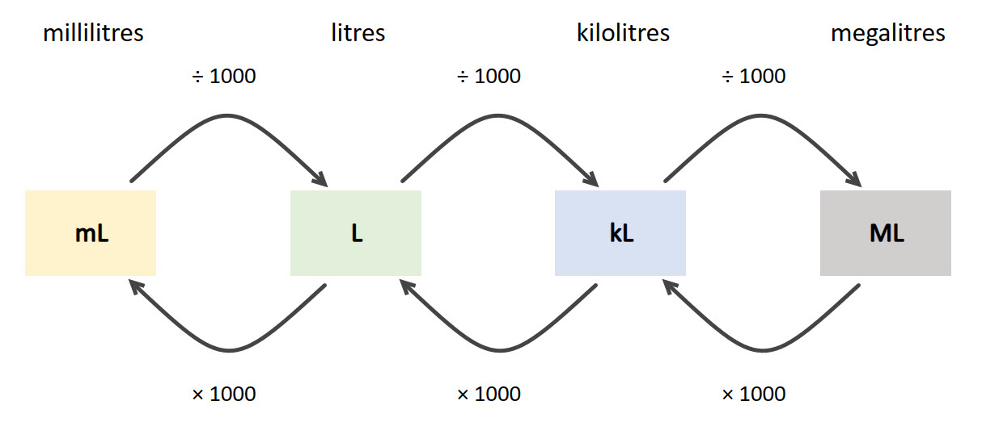
How to convert from one unit of measurement to another

Slide 8
Converting from one unit of measurement to another
A water tank holds 4500 litres, express this in kilolitres.
A backyard pool holds 6.25 kilolitres.
  express this in litres
  express this in megalitres
Which one is larger:
93,800 mL or 9.3800 L

Slide 9
Develop a set of instructions that explains how to convert between units of measurement without a calculator.
Include at least two examples.

Slide 10
Questions and prompts
How many places do the digits move when you ‘× 1000’? Why might that be?
How many places do the digits move when you ‘÷ 1000’? Why might that be?
What calculation has been applied when the digits move to the left, × 1000 or ÷ 1000? How do you know?
When converting a smaller unit of measurement, like millilitres, to a larger unit, like litres, does the size of the number increase or decrease?
How could you convert from L to kL, or kL to L, without using a calculator?

Slide 11
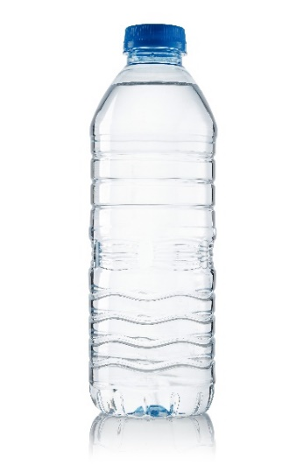
Exit ticket
Does the capacity of an object change when we convert the units of measurement from one to another?
  Yes / No
450 mL
0.450 L
0.00045 kL
0.00000045 ML
3 litres of water is equivalent to:
  0.003 kilolitres
  3000 kilolitres

