Slide 1
Number talk
Fraction shape puzzles warm-up
If the image below represents one quarter of the shape, what could the whole shape look like?

Slide 2
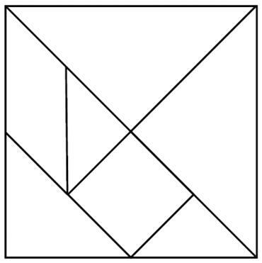
Tangram

Slide 3
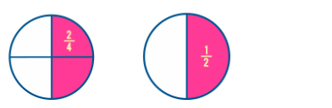
Equivalent fractions
… are different representations of the same value.

Slide 4
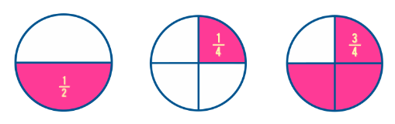
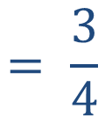

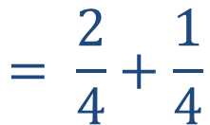
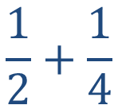
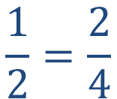
Fraction addition
$$\frac{1}{2}+\frac{1}{4}=\frac{3}{4}$$
$$\frac{1}{2}=\frac{2}{4}$$
$$\frac{1}{2}+\frac{1}{4}$$
$$= \frac{2}{4}+\frac{1}{4}$$
$$= \frac{3}{4}$$

Slide 5
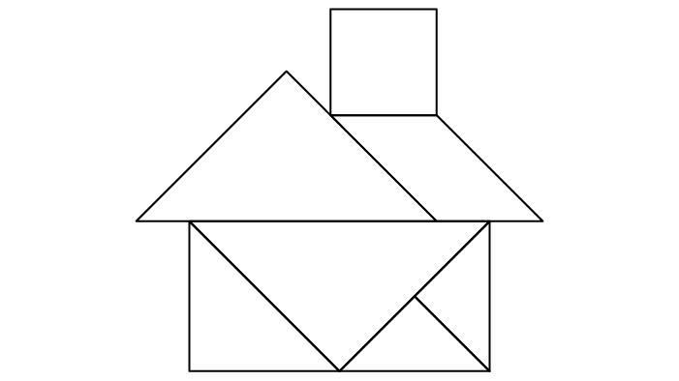
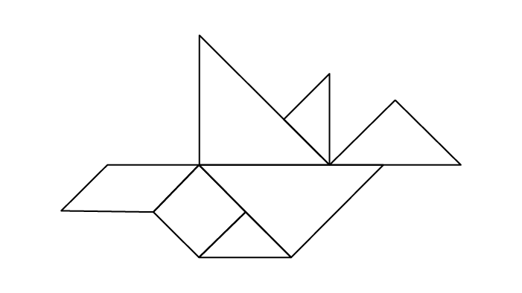
Tangram inspiration

Slide 6
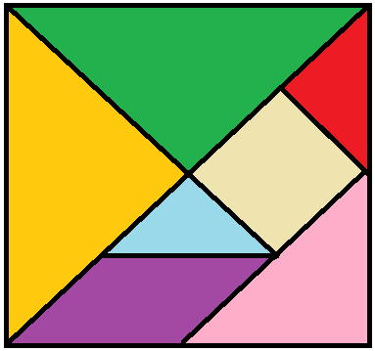
Fraction shape puzzles exit ticket
If the blue triangle is worth 1, what are the other shapes ‘worth’? Show your working.

Slide 7
Teachers’ notes
Sullivan and Lilburn (2015) state that ‘good’ questions are those which:
require more than remembering a fact or reproducing a skill
students can learn by answering the questions, and the teacher learns about each student from the attempt
there may be several acceptable answers.
In his Ted Talk (2010), Dan Meyer gives the following advice:
Use multimedia
Encourage student intuition
Ask the shortest question you can
Let students build the problem
Be less helpful
This time should be a safe maths space for students to share potential thoughts/answers without judgement.
Using this information as a general guide, pose this problem to your class and take on the role of facilitating- posing questions, giving students wait and pause time, allowing students to share their thoughts with others, and differentiating as required for all students to be challenged within their zone of proximal development. Take time at the end of the activity to summarise students’ thoughts, their progress in thinking and clarify any misconceptions.
Meyer, D. (2010, March). Math class needs a makeover [Video]. TEDx.
Sullivan, P. & Lilburn, P. (2015). Open-ended maths activities (2nd Ed). Oxford University Press.

