Slide 1
Making informed arguments

Slide 2
Learning intentions
We are learning to present our findings from our statistical investigation using an infographic.
We are learning about the key elements of making an informed argument.

Slide 3
Why do I need to know this?
Making informed arguments is about presenting your ideas accurately with evidence to support what you’re saying, so that your audience has confidence in your conclusions.
Understanding the key elements of making informed arguments also helps with analysing other’s ideas and claims.

Slide 4
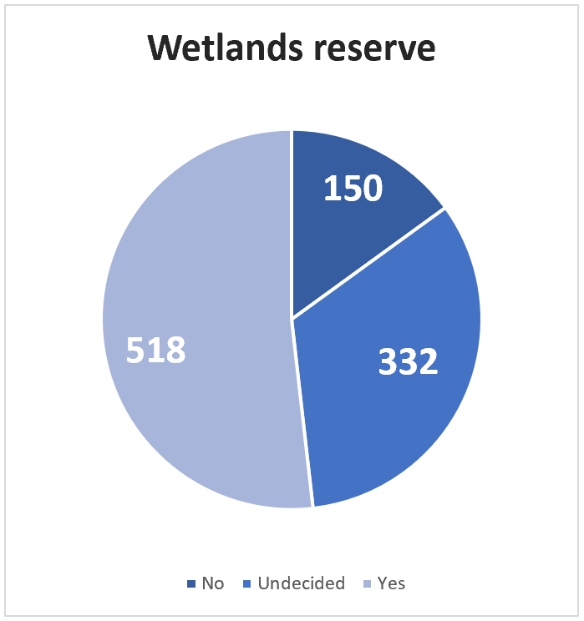
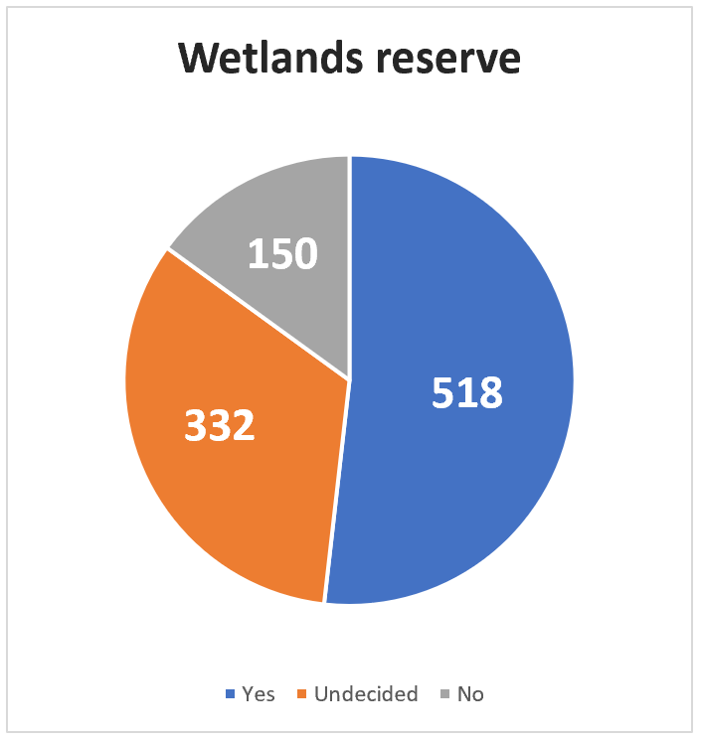
Two graphs - same data - different story
Over 48% of residents are against or unsure about the wetlands reserve
85% of residents are for or undecided about the wetlands reserve

Slide 5
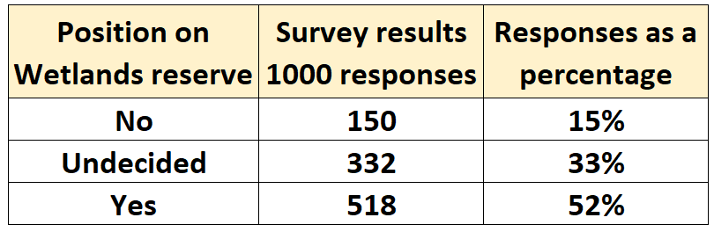
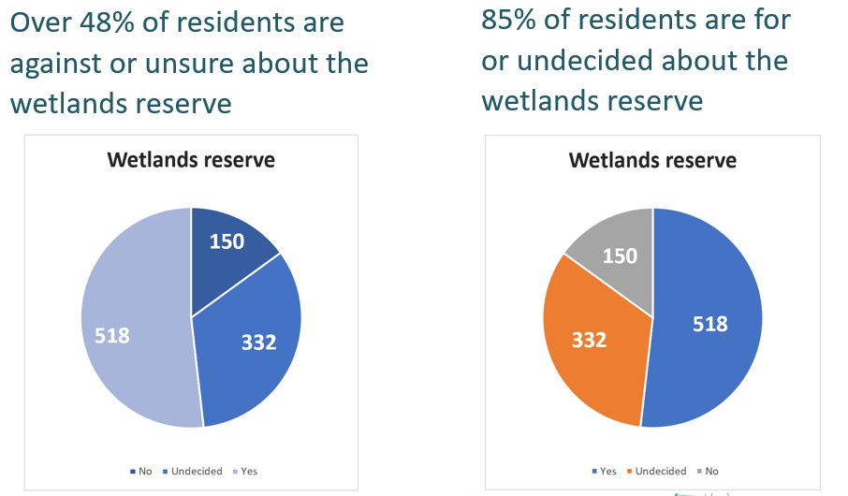
Same data, different story: closer look

Slide 6
An interesting statement
An Australia wide survey reveals that for 92% of Year 6 students, the more time they spend doing homework the happier they become!

Slide 7
Create infographic
Create an infographic based on your inquiry question and the findings from your statistical investigation.
Clearly state the inquiry question you researched
Outline your research approach and any assumptions made
Present findings in a way that is easy to understand and follow
Make sure your evidence (findings) back up your claims

Slide 8
Sharing reflections
Reflections can be shared using phrases such as:​
I wonder ...
I really like the way you have …
What if ...
I am not sure about ...

Slide 9
Exit ticket
Name 3-4 key things to include in your infographic that make your information trustworthy and believable:
…
…
…

